Slide 1


Slide 2

DATABASE PRESENTATION
Group # 3 Members :
Muhammad Huzaifa Farrukh (BCSF24M001)
Hamad Ashfaq (BCSF24M003)
Soman Abbasi (BCSF24M014)
Huzayfa Siddique (BCSF24M049)
Course Instructor : Dr.Irfana

Slide 3

INTRODUCTION & PROJECT GOAL
Initial Need for a System
The Solution IMDB Clone
Core Goals
Support User Interaction
Ensure Data Integrity
Efficient Complex Querying

Slide 4

EXECUTIVE SUMMARY: THE VISION
Mandate: To build the Digital Backbone of the Global Entertainment Industry
Mindset: "Scale-First" Architecture
Outcome: A Robust, ACID-Compliant Relational Engine

Slide 5

ARCHITECTURAL SCOPE: THE ENTERPRISE PHILOSOPHY
Focus: Data Governance over simple storage
Primary Goal: Create the Single Source of Truth (SSOT) for three critical domains:
Global Content Metadata
Talent Management
Financial Intelligence

Slide 6
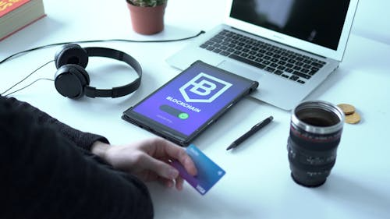
MOTIVATION: DESIGN RATIONALE
Relationship Fidelity
Historical Compliance
Business Rule Automation
Handling Volatility & Growth

Slide 7
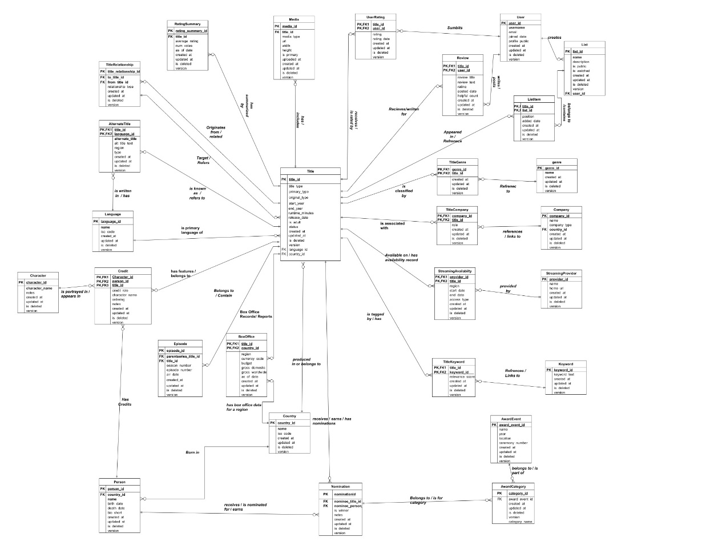
THE BLUEPRINT : ENTITY-RELATIONSHIP DIAGRAM (ERD)

Slide 8

RELENTLESS NORMALIZATION (3NF & BEYOND)
Why it cannot be further normalized:
Further Normalization (BCNF)
The Decision (Purity vs Practicality)

Slide 9
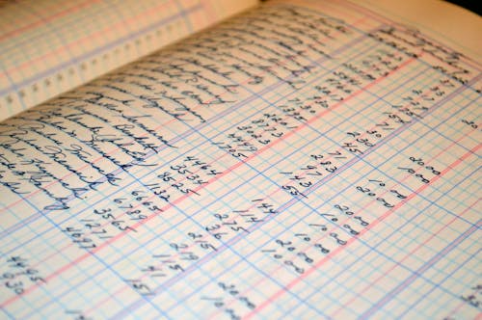
STRATEGIC DENORMALIZATION: THE PERFORMANCE TRADE-OFF
The Problem: Calculating AverageRating required joining 1.4 million UserRating records per query
The Solution: Created the RatingSummary table
The Logic
Impact: Reduced query read-time from seconds to milliseconds

Slide 10
DOMAIN RESEARCH & INVIOLABLE BUSINESS RULES
Method: Reverse-engineered 20+ Inviolable Business Rules from domain research. Examples:
The "Highlander" Rule
Temporal Logic
Referential Integrity

Slide 11
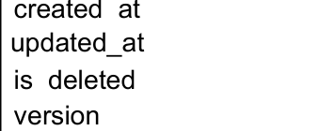
IMPLEMENTATION: THE "SOFT DELETE" ARCHITECTURE
Decision: Rejection of destructive DELETE
Mechanism: Is_Deleted, Deleted_At, and Version columns across all 28 tables
Impact: Guarantees Referential Integrity
The "Time-Travel" Capability

Slide 12

STORED LOGIC: THE AUTONOMOUS BRAIN
Goal: Programmed the database to think Two Components:
Stored Procedures
Triggers (The Automated Immune System)
Focus: Implementing the complex logic required for the Denormalization Strategy and Auditing

Slide 13
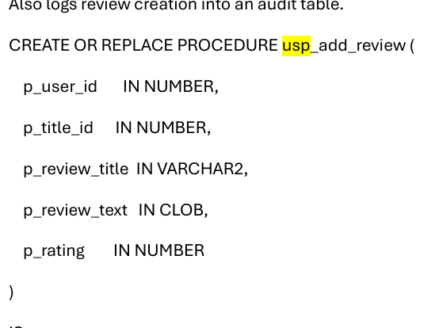
DEEP DIVE: STORED PROCEDURES
Purpose: Atomic execution of multi-step business transactions Key Example: usp_add_user_rating This procedure is the Guardian of the Rating System, handling insertion and immediately triggering calculation updates in one atomic, serialized unit

Slide 14
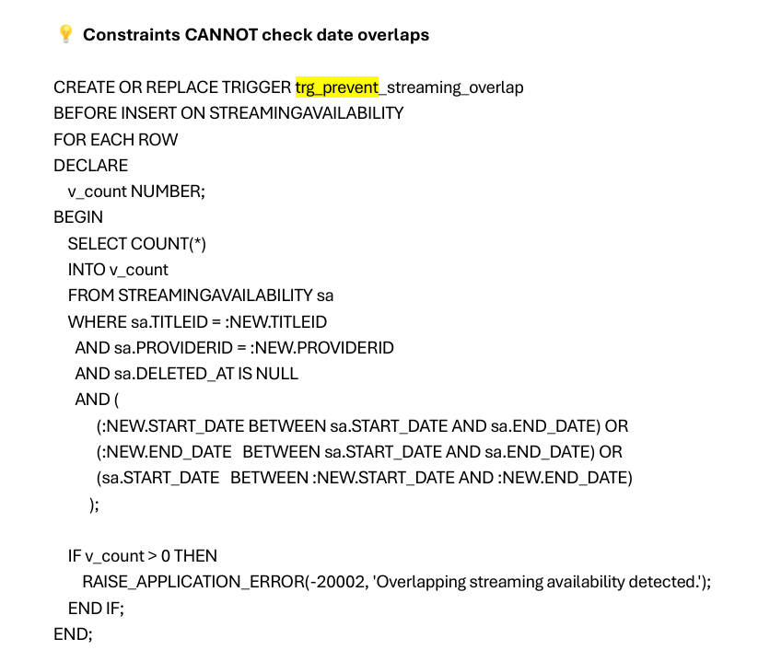
DEEP DIVE: TRIGGERS (The Immune System)
Purpose: Automated event handlers to enforce rules and maintain data integrity in real-time. Key Example: trg_prevent_streaming_overlap This trigger enforces Temporal Logic, using complex checks to ensure streaming dates do not conflict for the same provider/title

Slide 15

CRISIS & SOLUTION: THE MUTATING TABLE ERROR
The Crisis: We hit ORA-04091—a row-level trigger
The Impact: Brought development to a standstill
The Fix: Architectural Pivot—Refactored the logic from a failed Trigger to a Transactional Stored Procedure

Slide 16
INTEGRITY CHALLENGE: THE SOFT DELETE PARADOX
The Conflict : Use of Soft Deletes (is_deleted = 1) to preserve history
The Constraint: A movie must have a unique set of tags (e.g cannot be "Action" twice).
The Paradox: A standard UNIQUE Index blocks re-adding a tag, even after it has been "soft deleted”
The Failure Scenario: Deleted rows haunt the system and prevent new, valid data entry.

Slide 17
ENTERPRISE SOLUTION: THE REACTIVATION PATTERN
Strategy: Replaced "Blind Inserts" with a "Smart Upsert" (Update/Insert) logic.
Logic Flow :
Check: (Existence of Relationship)
If Found & Deleted: Update the old row to is_deleted = 0
If Not Found: Insert a new row
Key Benefit : (Audit Integrity)
Avoids wasting Primary Keys
Preserve the original created_at timestamp

Slide 18
END-TO-END FLOW OVERVIEW
THE INGESTION & ENRICHMENT LIFECYCLE
THE ENGAGEMENT LIFECYCLE
LOGISTICS & RECOGNITION (BUSINESS SIDE)
INTELLIGENCE (The Analytics Loop)
All Associative Entities use a Surrogate Key

Slide 19
PHASE 1: THE INGESTION & ENRICHMENT LIFECYCLE (ADMIN SIDE)
Core Creation (The Foundation)
Classification & Keywords
Globalization (Alternate Titles)
Digital Assets (Media)
Universe Building (Title Relationships)

Slide 20
PHASE 2: THE ENGAGEMENT LIFECYCLE (User Side)
User Onboarding
Action : A new row created when user registers
Privacy : Their profile_public is set to 1 (default)
Curation (Lists & Watchlist)
Create List : User creates List in List Table
Add Item : User adds via List Item
Interaction (Rating & Review)
Rating : User gives it 10/10
Review : User writes it “Masterpiece”

Slide 21
PHASE 3: LOGISTICS & RECOGNITION (Business Side)
Financials & Streaming :
Revenue: Admin logs the $800M earnings in BoxOffice, linked to CountryID
Distribution: Admin schedules it on Netflix via StreamingAvailability
The Prestige (Awards) :
Nomination
The Win: Admin updates is_winner = 1

Slide 22
PHASE 4: INTELLIGENCE (The Analytics Loop)
Batch Processing
Nightly Job: The procedure usp_calc_title_pop runs
Calculation: It aggregates the new Rating, the new List Add and the new Streaming availability
Result: Updates the Title Popularity

Slide 23

VIEWS: DATA ABSTRACTION FOR ANALYTICS
Purpose: Simplified data access layer for application development and reporting.
Key Benefit: Provides pre-joined, filtered, secure datasets for common queries. Example: VIEW Title_Full_Details (Consolidates Title, Rating, Box Office, and Cast).

Slide 24

ANALYTICS: UNLOCKING BUSINESS VALUE
Mantra: The true value is in insight, not storage
Techniques: Advanced Window Functions, CTEs, Statistical Aggregations
Audience: Designed for C-Level, Content Acquisition, and Financial Analysts

Slide 25
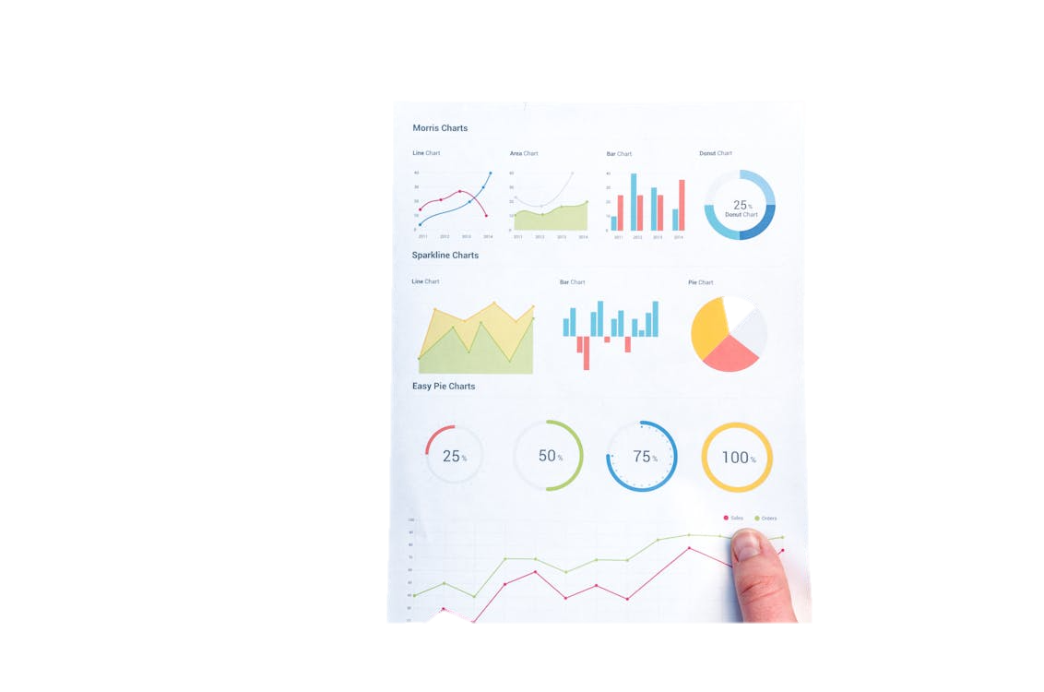
ANALYTICS DEEP DIVE: FINANCIAL INTELLIGENCE
The "Blockbuster" Efficiency Report : Calculated Return on Investment (ROI) % by Genre.
Insight: Thriller movies demonstrated a 1,254% ROI, identifying them as the most efficient investment.
Revenue Per Minute: Calculated "value density."

Slide 26

ANALYTICS DEEP DIVE: CONTENT DISCOVERY
The "Streaming Gem" Hunter
The "Cult Classic" Detector

Slide 27

TESTING & VALIDATION: THE "CHAOS MONKEY" APPROACH
Method: We intentionally tried to break our own database.
Test Harness
Error Handling: The system successfully blocked every invalid attempt

Slide 28

PERFORMANCE & OPTIMIZATION STRATEGY
Required by User
Indexing
Query Tuning
Concurrency

Slide 29

CONCLUSION & FUTURE ROADMAP
Summary: Successfully engineered a database engine that is Robust, Historical, and Scalable.

Slide 30
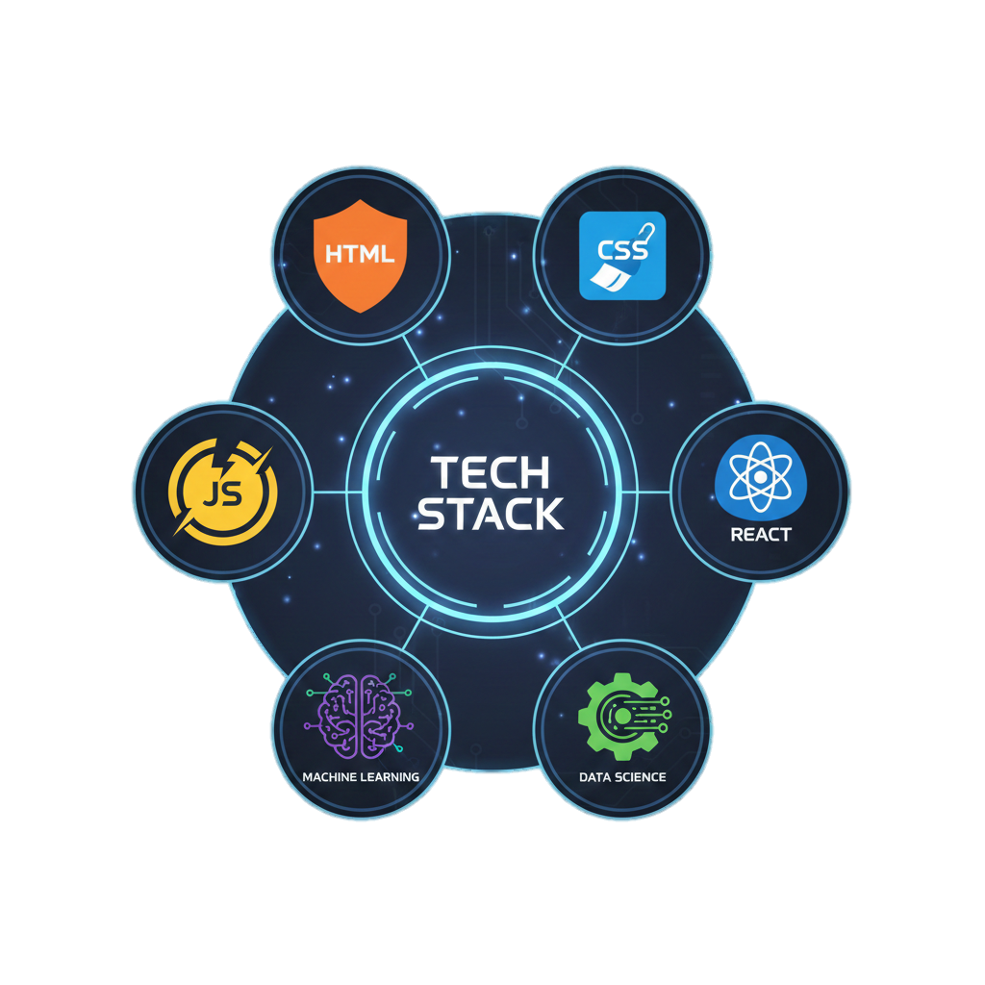
FUTURE SCOPE and Q&A
Frontend Development
Performance Optimization
Machine Learning

Slide 31
THANK YOU! DO YOU HAVE ANY QUESTIONS?

